Slide 1
Fatalities in Transport
Group members: Robert, Maozhu, Dat, Brendan.

Slide 2
Aim and Questions
Aim: To understand some of the reasons behind transport crashes of all types of non-military transport in the United States.
Have vehicles become safer over time?
What is the safest mode of transport per mile?
What are some of the factors that can cause fatalities?
Which are the safest states in the United States for transport?
Which are the most dangerous states in the United States for transport?
We have decided to answer these questions to better understand what modes of transport are safest, and some of the factors that can affect safety.

Slide 3

Plane Crash Data Analysis

Slide 4
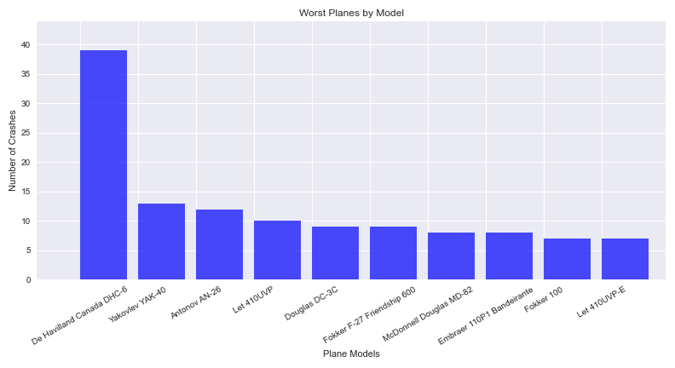
The top 10 worst planes by crashes in 1991-2020
This bar chart shows the most dangerous plane due to the number of crashes. The De Havilland Canada DHC-6 between 1991-2020 was the worst.

Slide 5

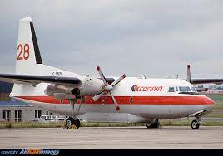


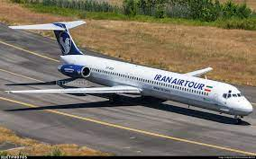


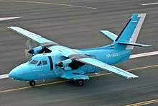

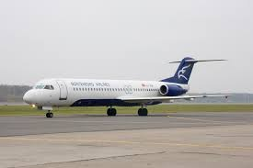
What are these planes?
Douglas DC-3C
Fokker F-27 Friendship 600
De Havilland Canada DHC-6 Twin Otter 300
Yakovlev YAK-40
McDonnell Douglas MD-82
Embraer 110P1 Bandeirante
Antonov AN-26
Let 410UVP
Fokker 100
Let 410UVP-E

Slide 6
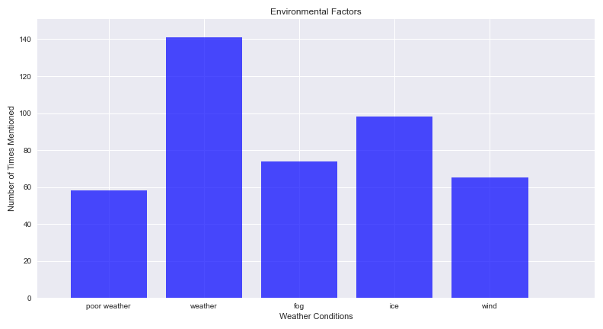
What contributed to fatal accidents?
There were 1101 plane crashes between 1991-2020
The group considered factors that could contribute to plane crashes and put them into categories of environmental, human error and mechanical failures.
We researched these categories by using the str.contains() method in the Summary of Events data to find common vocabulary after reading through a few examples.
This bar chart shows the number of accidents in which “poor weather”, “weather”, “fog", "ice” and “wind were mentioned in the reasons for the crash.
Weather was mentioned 141 times for 1101 flights that crashed. This was split into fog (74), ice (98) and wind (65) as well as “poor weather” (58).

Slide 7
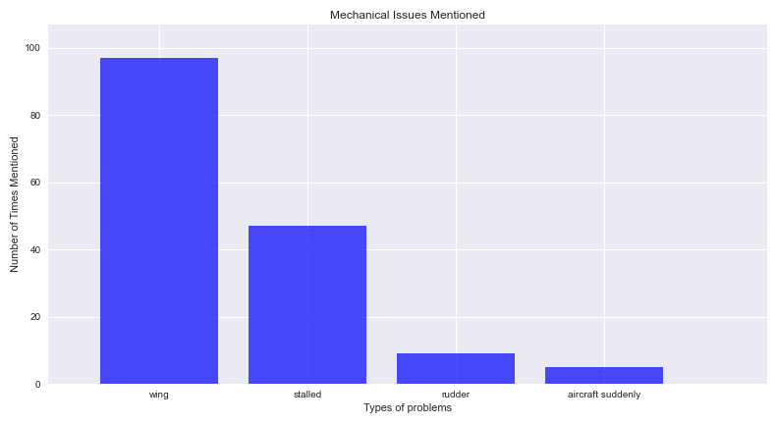
Mechanical Issues that Contributed to Failure
This bar chart shows the number of accidents in which “wing”, “stalled”, “rudder” and “aircraft” were mentioned in the reasons for the crash.
Wings were the largest issue with 97 mentions out of 1101 crashes which was twice as often as “stalled” in the event summary data.
Thankfully very few flights had sudden issues or rudder failure.

Slide 8
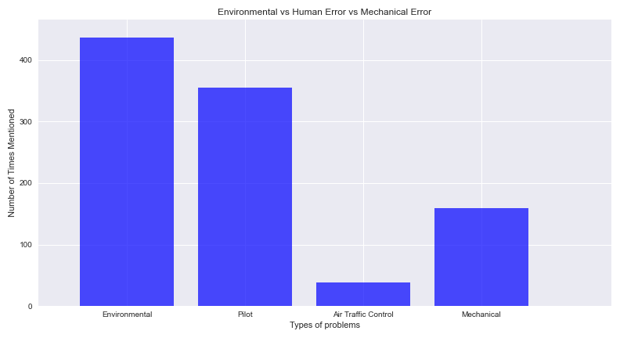
Human Error Involved in Plane Crashes
Human Error in planes crashes was counted by using variations of “pilot” or “air traffic control”.
Included in the bar chart are the total environmental factors and the total mechanical issues for a comparison.
In conclusion, the environmental and pilot errors are the major contributing factors in plane crashes.

Slide 9
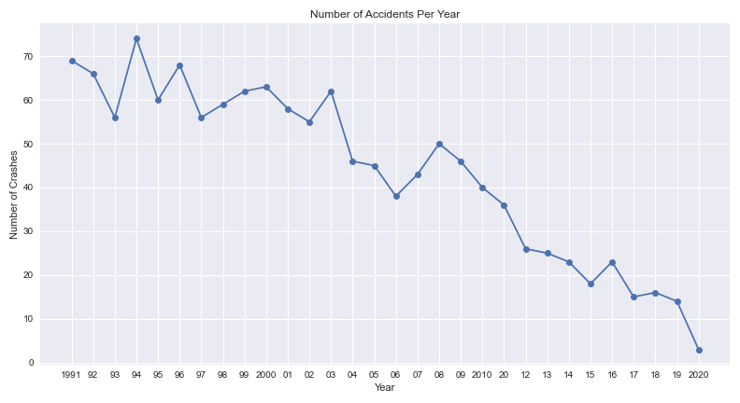
Has Aviation Become Safer?
This graph shows the number of total plane crashes per year between 1991-2020. This shows a trend of aeroplanes becoming safer over the last 30 years.

Slide 10
Summary of Data
In this data set, the average number of people on commercial planes was 36 and the average number of fatalities was 25.
The number of commercial plane crashes with one fatality or more is 1078 out of 1101.
The most common areas for aircraft failure are:
Hawaii with 6 incidents, Alaska with 5 incidents and Arizona with 2 incidents.
The number of plane crashes has reduced dramatically over the past 30 years.
The De Havilland Canada DHC-6 was statistically the most dangerous plane to fly between 1991-2020.
Wings were the largest mechanical issue. Weather in general was a major contributor to crashes but ice was mentioned the most. Pilot choices were by far the most important part of human error.
In conclusion, the environmental and pilot errors are the major contributing factors in plane crashes.
The chance of survival on plane crashes with 1 or more fatalities is 31.6 percent.
Data Source:
Kaggle Datasets, “Airplane Crash Data Since 1908”, sourced from http://www.planecrashinfo.com
Data Limitations:
If I am in a crash, in which mode of transport am I most likely to survive?

Slide 11

Train Accident Data Analysis

Slide 12
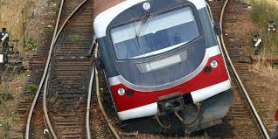

Question of Interests
Whether train has become safer in the US, and what can be improved to make it safer?
Notes:
1. train is till a major transportation for both goods and human.
2. Whether train is safer than other vehicle, no total passenger carried

Slide 13
Data Strategy & Sourcing
Understanding existing train accidents in US:
Whether safe:
Investigate total number of accidents against years
Investigate total number of fatalities against years
What to be improved:
Primary cause for these existing accidents
Any location with more accident numbers
Any factor is proved to be correlated to fatality
Primary: Rail Equipment Accident/Incident Data from FRA in the US Department of Transportation
Info available: recording details of accidents, e.g., time related, equipment type, weather, railroad etc.
Available records: 214K rows and 159 columns recording from year 1975 till 2022.
Data
Source:
Notes:
1. Government body, with a form available to record information of each accident

Slide 14
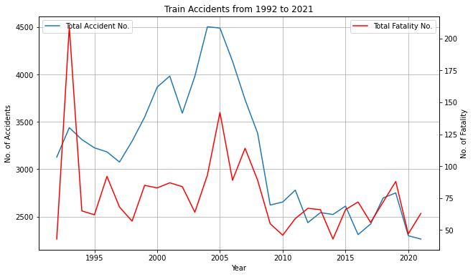
Data Manipulation & Analysis
Total number of accidents & fatalities?
Each row of the dataset is a record, and count rows to get total accidents
“Total Persons Killed” is available and using the sum() function
Generate a line plot to show their trending performances
10-year average number of accidents and fatalities are calculated to further prove trends

Slide 15
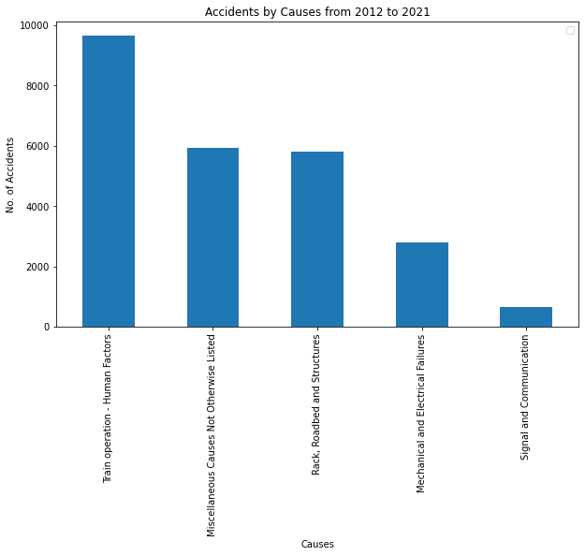
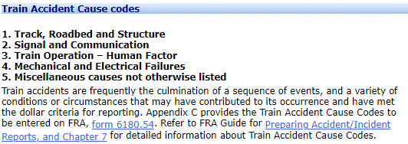
Data Manipulation & Analysis
Primary causes for existing train accidents?
“Primary Accident Cause Code” is recorded (each accident is only with one primary cause)
The file with all codes is available from FRA (390 codes in total), categorized into 5 causes (available below)
Generate a bar plot showing the total number of accidents under each cause
Source: FRA Office of Safety Analysis
Notes:
human factors like employee physical condition, train operations
track: track geometry, anchoring, appliances
Miscellaneous like crossing, environment related

Slide 16
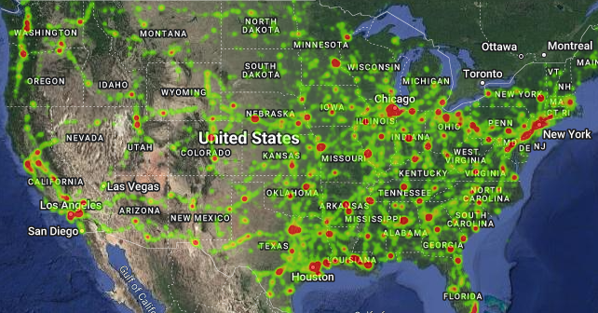
Data Manipulation & Analysis
Any location with more accident numbers?
“Latitude” & “Longitude” of accident locations are recorded in datasets
Generate a heatmap to show any place with higher accident occurrences

Slide 17
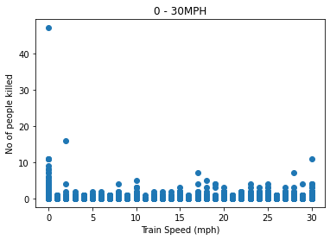
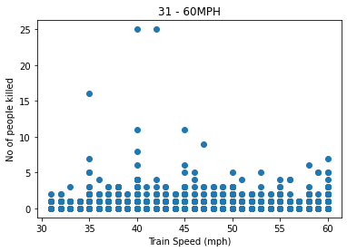
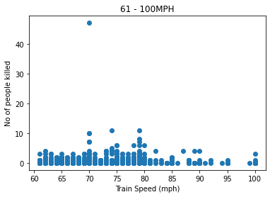
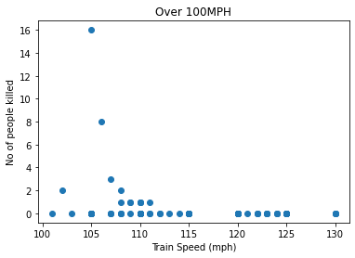
Data Manipulation & Analysis
Any factor is proved to be correlated to fatality?
“Train Speed” is available, and there are 214154 records with speed info for recorded 47 years (the max 545 mph is ignored)
Speed is divided into 4 segments:
0-30 mph; 31-60 mph; 61-100 mph; over 100mph
Scatter plots and linear regression are adopted to qualitatively and quantitatively see whether any correlations (all absolute r_values are below 0.2)

Slide 18


Summary
The total number of train accidents has reduced to an average level of 2,500 for 10 years (2012-2021) from an average level of 3,500 (1992-2001, 2002-2011); while for fatalities, the 10-year average level has reduced from 80 (1992-2001, 2002-2011) to 65 (2012-2021).
The data imply that in the US train has become safer between 2012 – 2021, but some limitations of this conclusion include impacts of covid-19 with fewer train movements are not considered.
The human factor is the primary cause for years between 2012-2021, specifically among 24,832 accidents 38.9% is due to human factors; location-wise, many major cities like New York, Chicago, and Houston are still with high occurrences, which suggests that more resources may be invested on staff training and these cities to improve overall train safety in the US.
Notes:
No total number of accidents

Slide 19
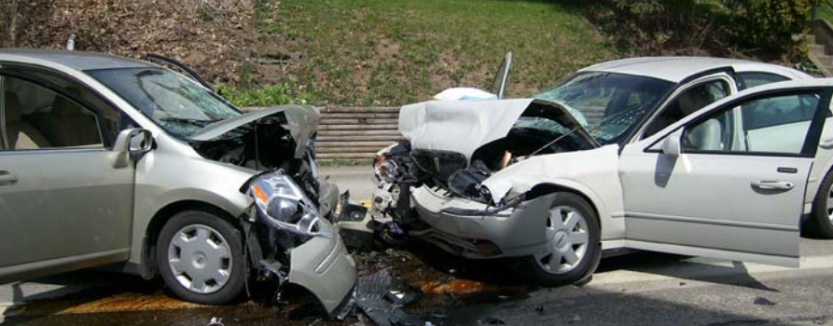
Motor Vehicle Traffic Crashes Analysis for the USA

Slide 20
Question of Interests
What is the trend of motor vehicle fatal crashes in the US?
How were the motor vehicle fatal crashes distributed among the states?
What factors contributes to the motor vehicle fatal crashes?
Is motor vehicle safe compare to train and airplane?

Slide 21
Data collection
Data Source:
Core data: National Highway Traffic Safety Administration Crash data Application Programming Interface (API) & Report.
https://crashviewer.nhtsa.dot.gov/CrashAPI
Bureau of Transportation Statistics.
https://www.bts.gov/content/us-vehicle-miles
Data information:
Records of Motor vehicles accidents and information related such as time, location, vehicle, driver… from 2010 to 2020.
Vehicle miles travelled and population data from 2010 to 2020

Slide 22

Data exploration and clean up.
Loops through various tables and years due to limited allowable records per download.
Convert data and save to csv to explore.
Remove columns not related to our questions to reduce the data size as original data >1GB.
Check data types and convert to right format.
Categorize the data using cut/bin procedure. Handle the missing/null values.
Save the clean data for analysis.

Slide 23
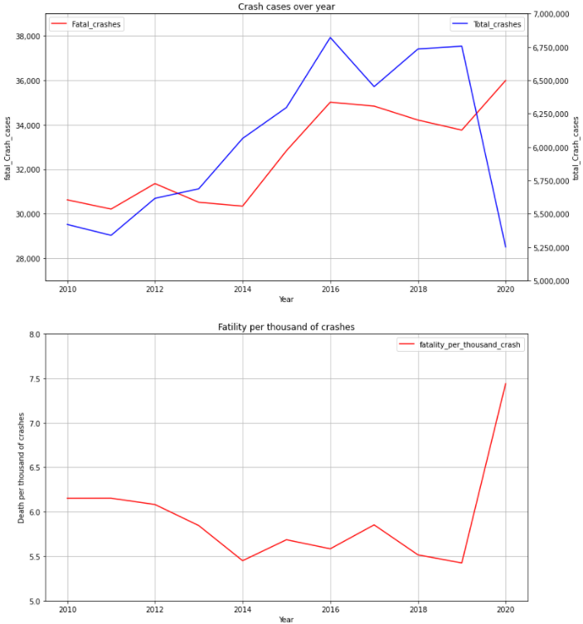
Data analysis: Motor Vehicle Crashes over years
Aggregate the total fatality number over years.
Merge data between fatal and non fatal crashes
Calculate the ratio between fatal crashes over total crashes.
Results:
Total number of crashes increased over years from 2010 to 2019 and drop in 2020 due to Covid 19 pandemic.
Number of fatal crashes still increased in 2020 although total number of crashes decreased
In average, there were ~5.5-6 people death in every 1000 crashes from 2010-2019. This number increased to 7.5 death per a thousand crash in 2020.

Slide 24
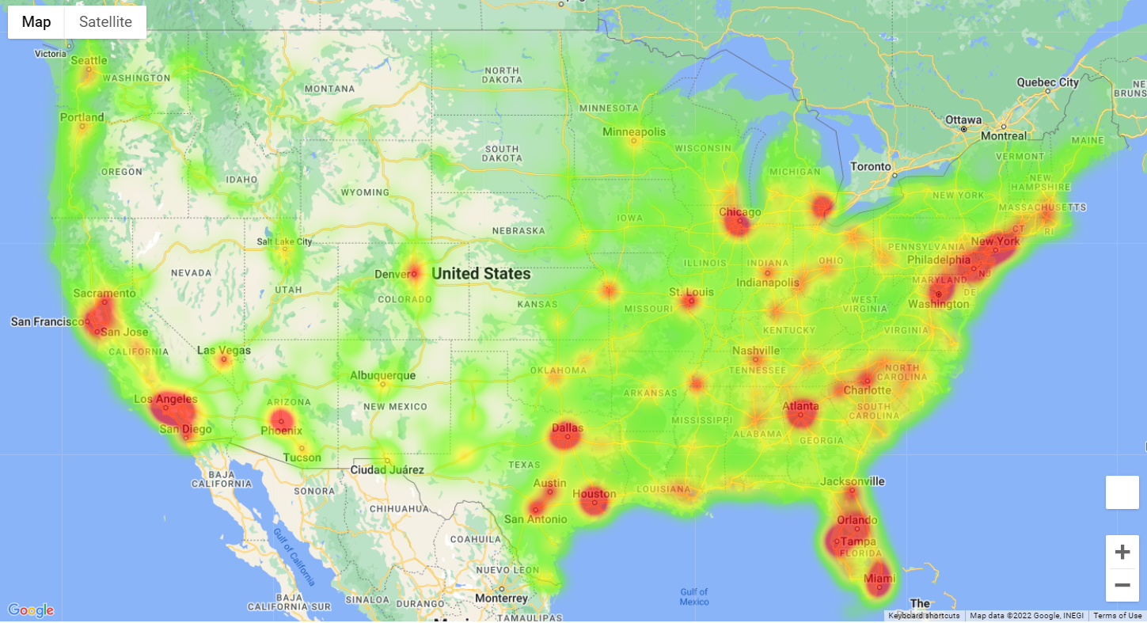
Visualize the fatal crashes over the states
Plot the heatmap using the Longitude and Latitude data available in the dataset with the number of deaths as a weight.
East coast has more fatal crashes than west coast.
Most of the crashes happened in the big cities of the states

Slide 25
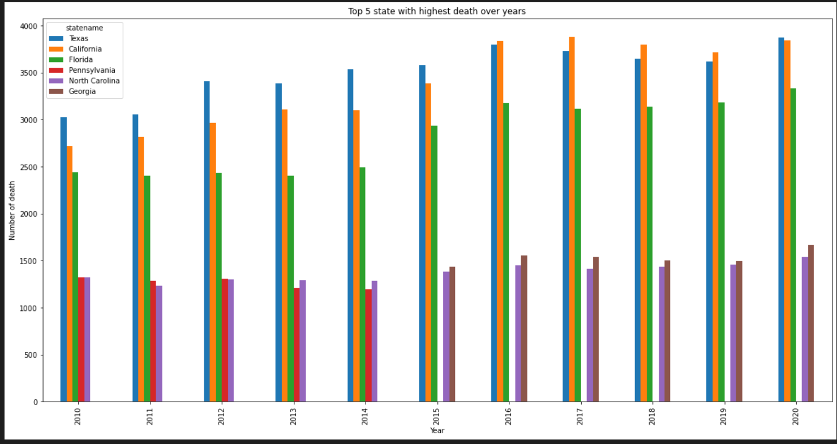
Top 5 states with highest number of death due to motor vehicle crash.
Aggregate the fatality number by states. Create a pivot table by year (rows) and state name (columns).
Texas /California/Florida were the top 3 state with highest number of death.
Pennsylvania improved and not in the top 5 since 2015.

Slide 26
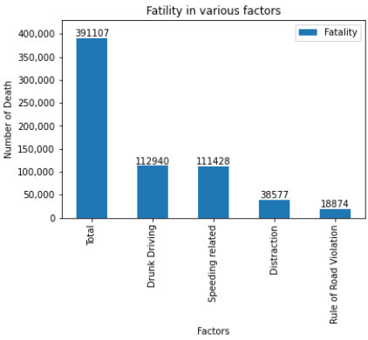
Motor Vehicle fatal crashes due to various factors
There is no primary caused of the fatal crashes for the dataset. Factors were not mutually exclusive (eg: driver could be drunk driving and also speeding).
Merge the data from various tables using case number and year as the unique key.
Categorize the caused code to the factors.
Aggregate the data to a summary table and plot.
Drunk driving and Speeding are the most dangerous. For every 3 fatal crashes, there is almost 1 case related to drunk driving. Similarly rate for Speeding.

Slide 27
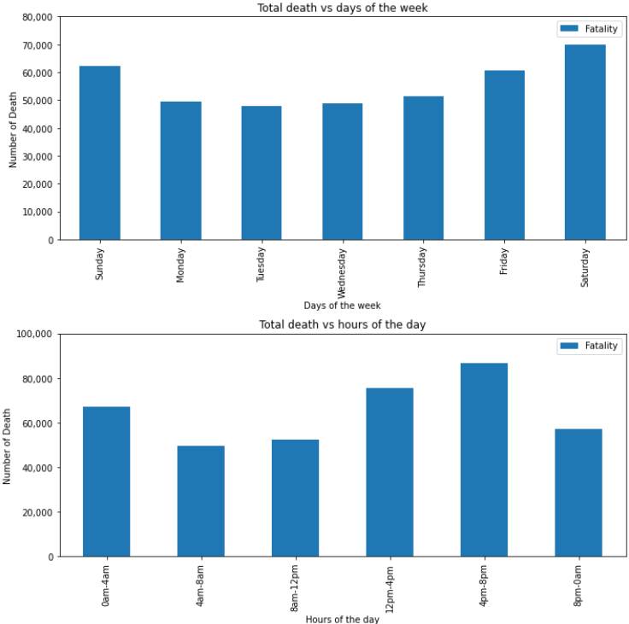
Motor vehicle fatal crashes per days and hours
The dataset has days of the weeks when the accidents happened. Index and sort the days of weeks before plotting so the days appear in order in the plot.
Categorize the hours to 6 period.
Saturday has the highest number of death compare to others days. Friday, Saturday and Sunday are the top 3.
From 4pm to 8pm has the highest number of death. Number of death happened at night time is about equal to number of death happened at day time despite there is much less traffic.
Driving at night is also a risk factor.

Slide 28
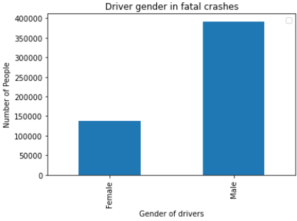
Drivers gender in fatal crashes
Merge the gender table to the data set using case number and year as a key.
Male involved in more fatal crashes than female, about 2.6x times higher.

Slide 29
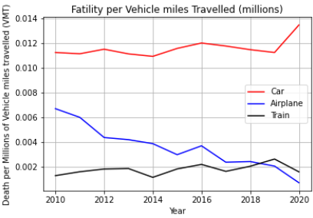
Fatal crashes per a million of vehicle miles travelled.
Merge the fatality dataset with the vehicle miles using year as key.
Calculate the fatality over vehicle miles travelled
Car is more dangerous than train and airplane.

Slide 30
Summary
Motor Vehicles has not become safer over years
Drug driving and Speeding are the most dangerous behaviours on road (involved is almost 1/3 of the fatal accidents).
Night time driving, male gender, distraction… are also the risk factors in motor vehicle fatal crashes.
Car is most dangerous mode of transportation compared to train and airplane.
Conclusion: Motor vehicles driving is still manual and mainly depends on the driver behaviours and the environmental situation.

Slide 31

Recreational Boat Crash Analysis For the USA

Slide 32
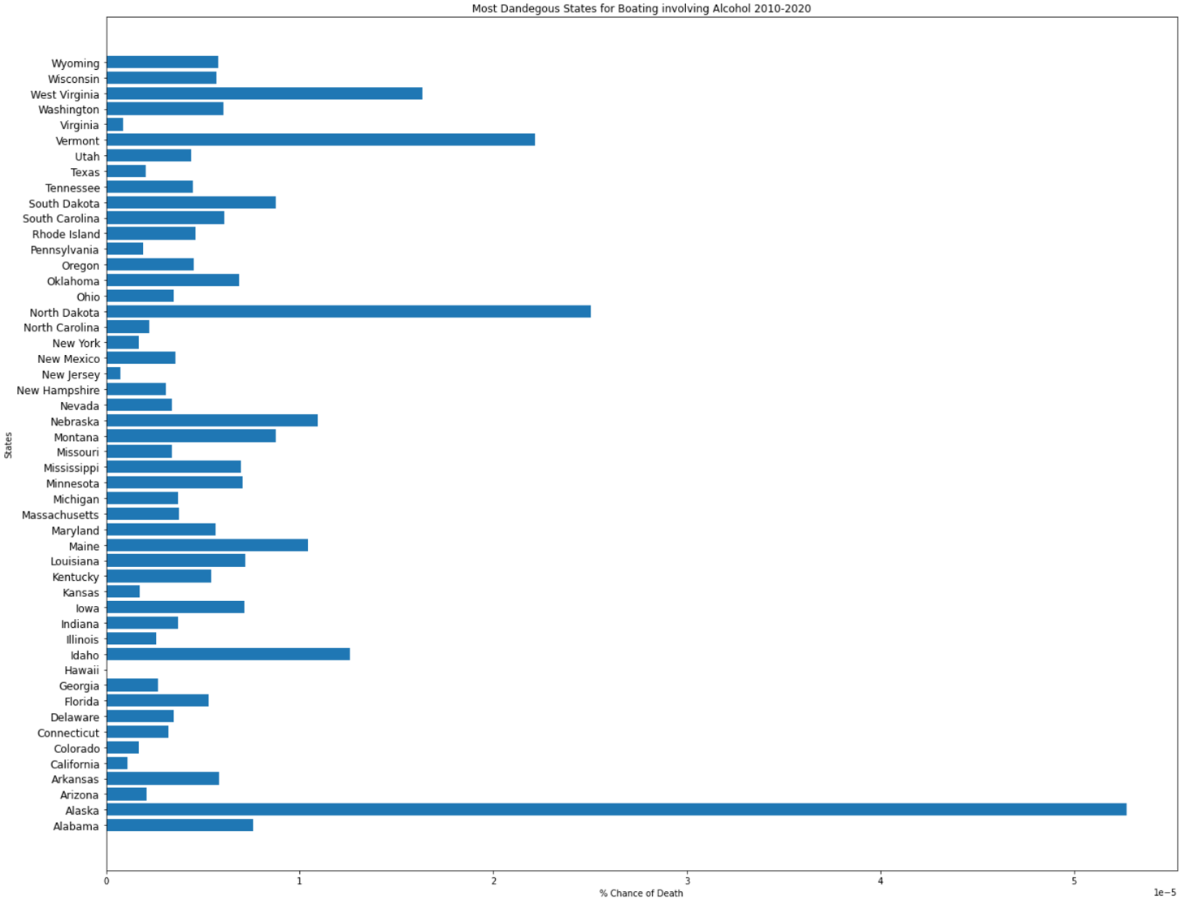
Most Fatalities Per State Involving Alcohol Per Average Population
This Plot shows the percentage chance of someone dying in each US state with alcohol as the main contributing factor. These figures were based on the total deaths with alcohol as the cause from 2010 through to 2020 and averaged per year, versus the average population for those years which was found in the US census 2010 and 2020.

Slide 33
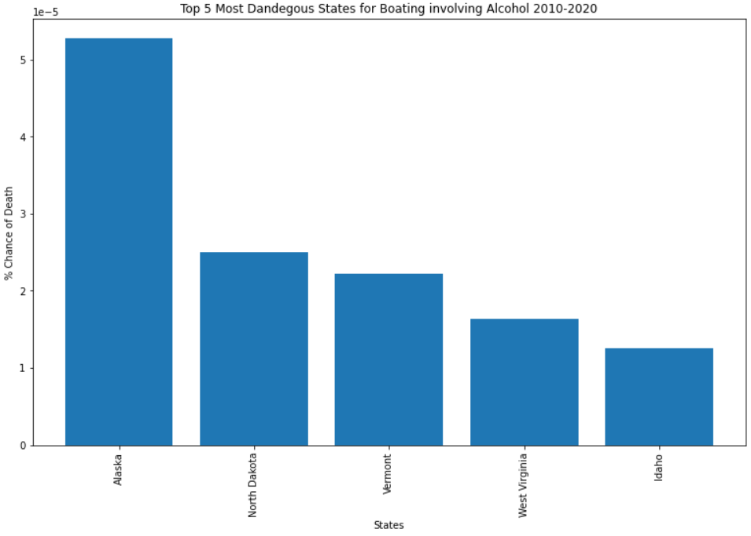
Most Fatalities Per State Involving Alcohol Per Average Population Top 5 States
The top 5 States for Fatalities with alcohol as the main cause, show that Alaska has over double the ‘Chance of Death’ as the 2nd highest state ‘North Dakota’.

Slide 34
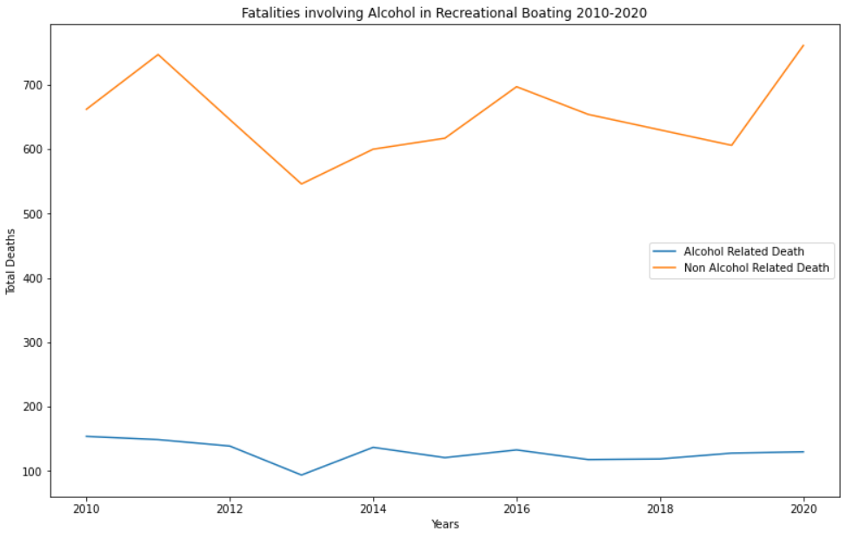
Fatalities Involving Alcohol versus Fatalities Not Involving Alcohol
This Plot show the comparison of Fatalities involving Alcohol as a main contributing factor compared to the total fatalities.
From this data we can see that although alcohol does contribute to the total deaths, it doesn’t make up a very high percentage as an overall factor of death in Boating.

Slide 35
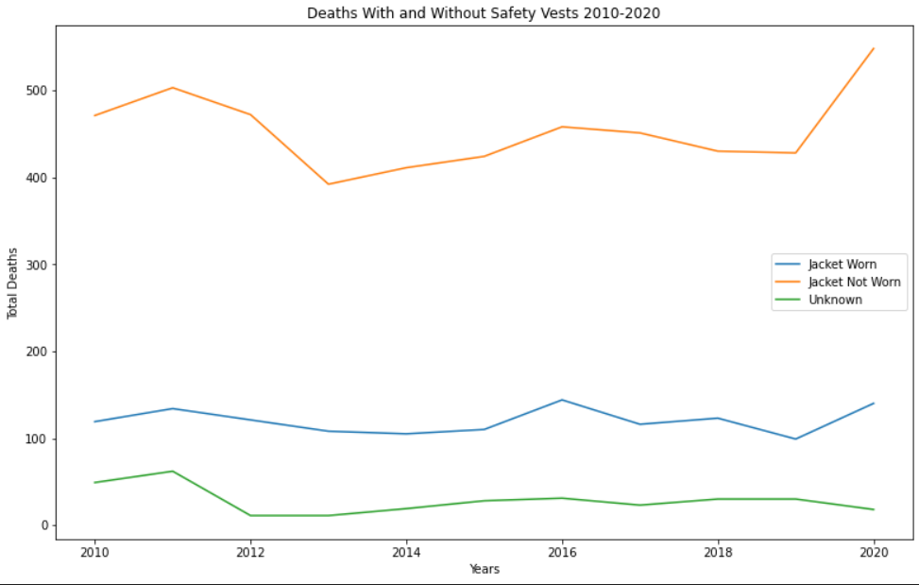
Fatalities Involving whether Safety Vests were worn between 2010-2020
The total deaths whilst wearing a safety vest has barely altered over the previous 10 years, and neither has the total deaths whilst wearing one. This graph clearly shows that there is a far higher chance of dying if you don’t wear a safety vest

Slide 36
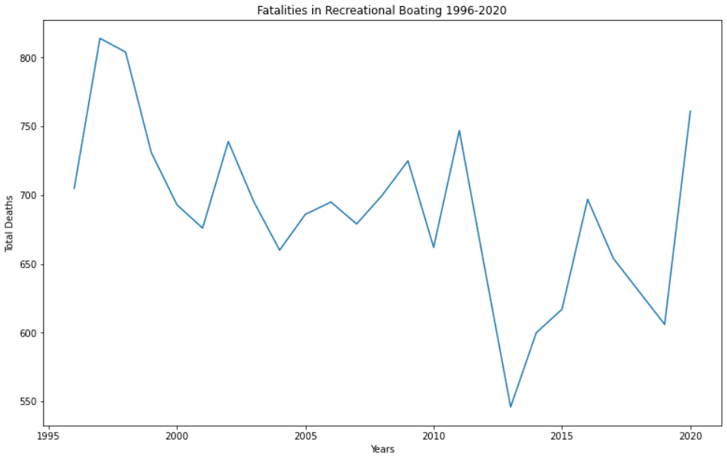
Fatalities in Recreational Boating 1996-2020
Fatalities in Recreational Boating since 1996 seemed to be heading in downward trend but over the more recent years appears to have a few spike years climbing back over 750 deaths in 2020.

Slide 37
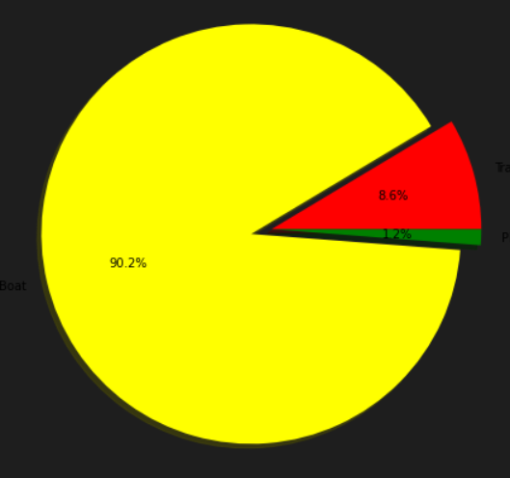
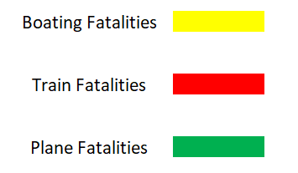
Comparing Total Boating, Train and Plane Fatalities between 2010-2020
This Pie graph shows the comparison between total deaths in Recreational Boating, Planes and Trains.
Slightly surprising Boats accounted for just over 90% of transport fatalities with these three modes of transport, with the other 2 making up less than 10%.
Cars were left out as the number of fatalities is so overwhelming in number for a head to head analysis.

Slide 38
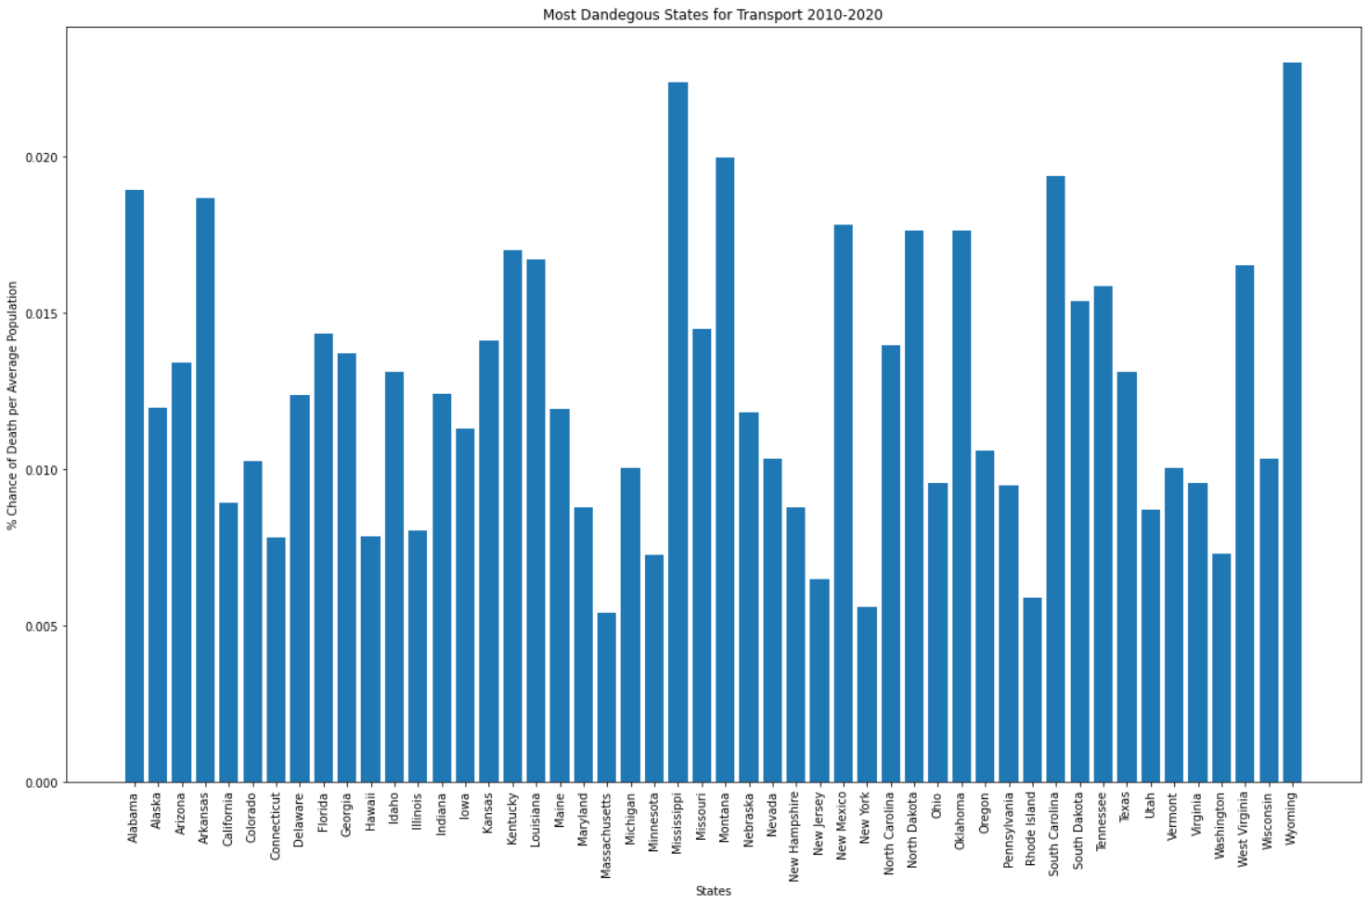
Most Dangerous States for Transport by Average Population 2010-2020
This Graph show the culmination of total fatalities for Trains, Cars, Planes, and Boats in all US states. Although Cars make up the vast majority of deaths, this graph takes into account the population average to give a better overall view of which states are Safest, and which are the most Dangerous.

Slide 39
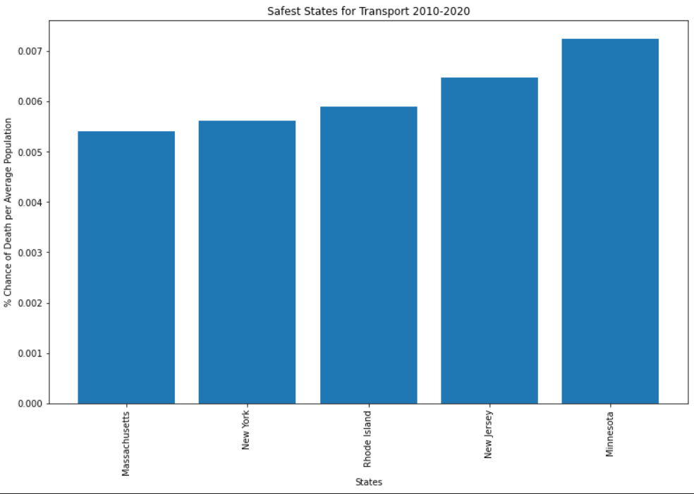
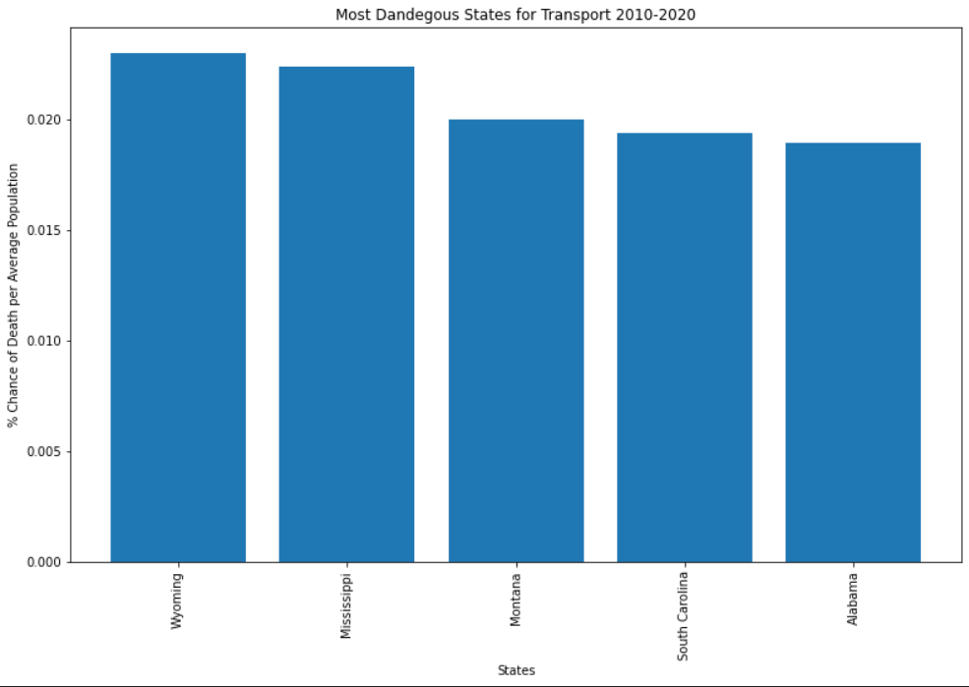
Top 5 Safest & Most Dangerous States for Transport by Average Population
In conclusion, the Safest states when it comes to Fatalities in Transport per capita is Massachusetts, followed by New York. Whereas the most dangerous states are Wyoming and Mississippi.

Slide 40
Summary
Alcohol shows to be only a minor factor in the cause for overall fatalities in boating.
Wearing a safety vest has far fewer deaths than compared to Not wearing a safety vest making a lack of safety vest a major factor in fatalities in boating.
There is only a slight trend downwards in the total fatalities in Boating over the past 25 years.
Recreational Boating has a far higher Fatality rate than either Planes or Trains, but pales in comparison to Cars.
With all 4 modes of transport explored the Safest states per capita were Massachusetts, followed by New York, and the most dangerous states Wyoming and Mississippi.
Post Mortem
Several difficulties arose, which included being unable to obtain good international data so we were restricted to the USA, as it has a solid array of data available.
Originally we wanted to focus on Plane Fatalities data but quickly realized there would not be enough for our whole group to explore, so we decided to include Car, Train and Boat Fatalities, for exploration.
Due to Car deaths being so overwhelming in numbers, it was hard to draw head to head comparisons with the other 3 modes of transport other than by miles travelled per death. Unfortunately this data was unavailable for Boats.
Ideally I would have liked to do a heat map of the US for all the Boat fatalities to see if more were located on the coast as opposed to rivers and lakes, but the Latitude and Longitude of these fatalities was unavailable.
Data Sources –
Recreational Boating Statistic, U.S. Department of Homeland Security U.S. Coast Guard Office of Auxiliary and Boating Safety
US Census 2010 & 2020 for Population data by State

Slide 41

The End
Any Questions?

